Slide 1
Microservices Architecture and API
CETM67 Assignment 1

Slide 2
Agenda
Topic | Speaker
Architecture Overview | Paul Jones
Microservice 1 | Paul Jones
Microservice 2 | Paul Jones
Microservice 3 | Paul Jones
Microservice 4 | Paul Jones
Lessons Learned & Final Thoughts | Paul Jones

Slide 3
Architecture Overview
Overview of complete system architecture and utilised AWS Services

Slide 4





System Overview Architecture
Architecture Scenario
This architecture is designed to support the BAE Onboarding tool developed for CETM65 and DXC’s British Aerospace Engineering account.
It’s purpose and stated aim is to allow the simple tracking of the onboarding status of new team members to the project, including visibility on the individual team members security clearance level as well as their DXC employee details.
There is room for expansion of the architecture to serve DXC as a whole, across multiple project teams and regions.
API Layer
Application/Persistence Layer
Employee
secureAccountCheck
cetm67-profile-pic
App.py
deleteObject
cetm67-sec-documents
resizeProfilePic
Architecture Explanation
The system architecture makes use of Heroku as a PaaS to host the Flask RESTful API file, called App.py. This can be communicated with via the different Test_API.py files, one for each Microservice. The Flask RESTful then communicates with a DynamoDB, S3 bucket or with a Lambda function.
The Lambda Functions communicate with either the DynamoDB or the S3 Bucket depending on the function called by the API. Response codes and JSON messages are returned to the user console.
It should be stated that the majority of system integration for this architecture would occur from the front end user interface that would sit atop the architecture. This again could be deployed via Heroku or hoisted on AWS itself.

Slide 5

Justification of Hosting/Access Choices
Heroku
Heroku was chosen as the deployment/hosting approach for the application for a number of reasons.
The primary reason being one of familiarity of how Heroku works and the deployment steps needed.
In addition, Heroku removed the requirement of managing an EC2 instance to host the files as it is PaaS.
In terms of scale, large scale deployment of the architecture may not be suitable for Heroku and an alternative such as API Gateway coupled with Lambda functions or EC2 instances should be considered. However, for the requirements of this system. Heroku was suitable and met all requirements.
Flask RESTful
Flask RESTful API was chosen as the method to code the API calls and responses primarily due to experience and familiarity with this approach.
API Gateway could also have been used, along with Postman to test the resulting API calls, however, due to time constraints and the new exposure to API tools and technologies, alongside new exposure to AWS and Cloud technology in the depth and use case that the author has been using, it was preferable to go with familiar technologies and techniques.
Flask Restful also allows more control over the code with testing and debugging as the code can be run locally on a computer and wont incur charges via the AWS cloud services.
AWS Programmatic Access
A unique user account was created specifically for this project.
Using principle of least privilege, the user was only provided with the bare minimum policies needed to interact with the chosen Amazon Services on offer: Lambda, DynamoDB and S3
A Unique key was generated and stored securely, using environmental variables on Heroku.
Depending on expansion/upscaling of the Infrastructure, more unique policies should be created, for example, the generic user should not have access to the Lambda functions, these would be used by Line Manager/Project managers, AWS itself, or sysadmins.
As the user should not have access to the AWS Web GUI itself, only programmatic access has been enabled for the user.
All actions will be activated via a front end GUI.

Slide 6
Microservice 1
User Details and Registration Service

Slide 7
Microservice 1 Architecture
Microservice Explanation
Microservice for registering new users onto the BAE Onboarding Website.
This includes CRUD tasks on the user records.
In reality, a website UI would be the trigger for API calls to the different AWS Services required
API Layer
Application/Persistence Layer
AWS Services Explanation
Heroku: Cloud PaaS based solution for hosting cloud based services. Can communicate with AWS services and Virtual Private Clouds via secure keys.
Flask: Python based Library for Website design, coded in conjunction with Flask RESTful API libraries
DynamoDB: NoSQL persistent, non-ephermal database. Makes use of Json format to store records, rather than creating schema for each table.
POST PUT GET DELETE
Authentication
Payload
Payload
Response
Response
The payload for this Microservice is the information required for the POST/PUT/GET/DELETE calls. This will be the mandatory arguments or user name to perform the operation on.
Justification
DynamoDB chosen because of NoSQL format. No requirement for schema means it is easy to adapt or add/remove attributes for each record as and when required by the business with no loss to functionality. Dynamo struggles with searching through large numbers of records, however, for the purposes of this microservice, data size will be small. Costs are reduced as we can predict usage and set provisioned capacity or use variable, on demand capacity if usage is not known.

Slide 8
Microservice 2
File Upload and Download Service

Slide 9
Microservice 2 Architecture
Microservice Explanation
Microservice for users to upload and download security clearance documentation (certifications and/or application forms) to a secure online storage facility.
Once a document is uploaded, the API will call the PUT request for Microservice 1 and update the relevant fields with the URL of the file.
Explanation
Heroku: Cloud PaaS based solution for hosting cloud based services. Can communicate with AWS services and Virtual Private Clouds via secure keys.
Flask: Python based Library for Website design, comes with RESTful API libraries
DynamoDB: NoSQL persistent, non-ephermal database. Makes use of Json format to store records.
S3: Simple Storage Service. Cost effective permanent object storage. Accessible by other AWS Services based on permissions and role assignments.
AWS Lambda: Serverless computing service designed for executing code without needing to manage infrastructure or servers to host said code.
API Layer
Application/Persistence Layer
POST GET
Authentication
Payload
Payload
Response
Response
The payload for this Microservice is the information required for the POST and GET requests. This will be the filename for GET, and the Filename and Employee_ID for POST.
PUT
Payload
Justification
DynamoDB chosen because of NoSQL format. No requirement for schema means it is easy to adapt or add/remove attributes for each record as and when required by the business with no loss to functionality. Dynamo struggles with searching through large numbers of records, however, for the purposes of this microservice, data size will be small. Costs are reduced as we can predict usage and set provisioned capacity or use variable, on demand capacity if usage is not known.
S3: Chosen because S3 is the AWS storage solution. S3 used rather than S3 Block because S3 offers cost effective storage for objects. As we are dealing with image files which should have very little interaction with multiple services in terms of editing or updating, block storage is not a required feature of the microservice. This further reduces costs.
Lambda is used here due to cost. Lambda charges per request ($0.20 per 1m) and this is cheaper than hosting even the smallest EC2 instance as the requests will not be frequent, even at scale. Speed is also a factor, time needed to activate an EC2 instance that is not started vs a lambda function that runs immediately on request.

Slide 10
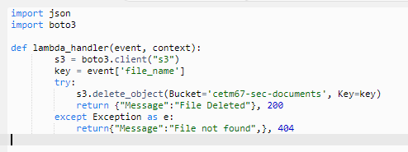
Microservice 2 Lambda Code

Slide 11
Microservice 3
Image Resize Service

Slide 12
Microservice 3 Architecture
Microservice Explanation
Microservice for automatically resizing a users profile image when it has been uploaded to an S3 bucket.
Useful to reduce demand on the S3 bucket and to reduce delay when displaying user images on the front end website.
API Layer
Application/Persistence Layer
Explanation
Heroku: Cloud PaaS based solution for hosting cloud based services. Can communicate with AWS services and Virtual Private Clouds via secure keys.
Flask: Python based Library for Website design, comes with RESTful API libraries
AWS Lambda: Serverless computing service designed for executing code without needing to manage infrastructure or servers to host said code.
S3: Simple Storage Service. Cost effective permanent object storage. Accessible by other AWS Services based on permissions and role assignments.
POST GET
Authentication
Payload
Payload
Response
Response
The payload for this Microservice is the information required for the POST and GET requests. This will be the filename for GET, and the Filename and Employee_ID for POST.
Justification
Lambda is used here due to cost. Lambda charges per request ($0.20 per 1m) and this is cheaper than hosting even the smallest EC2 instance as the requests will not be frequent, even at scale. Speed is also a factor, time needed to activate an EC2 instance that is not started vs a lambda function that runs immediately on request.
S3: Same reasons as before, cost effective storage for objects. As we are dealing with image files which should have very little interaction with multiple services in terms of editing or updating, block storage is not a required feature of the microservice. This further reduces costs.

Slide 13
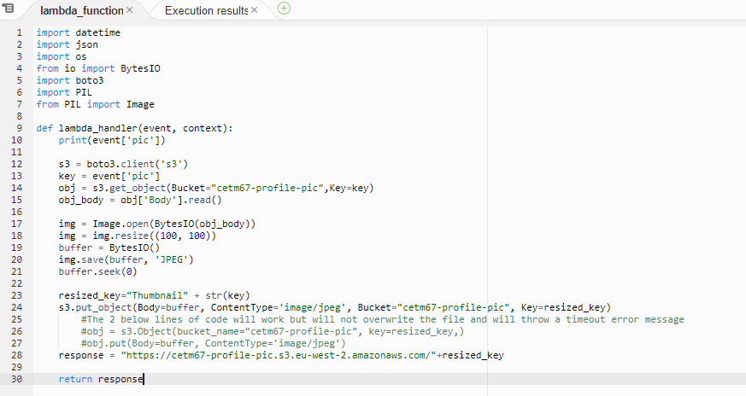
Microservice 3 Lambda Code

Slide 14
Microservice 4
User Clearance Level

Slide 15
Microservice 4 Architecture
Microservice Explanation
Microservice for Delivery Leads/Project Managers to search for current employees who can be assigned to secure projects based on security level.
Initially this is done on a per-employee basis but can also be used to search through multiple records based on defined criteria, such as Line Manager, physical location etc.
API Layer
Application/Persistence Layer
Explanation
Heroku: Cloud PaaS based solution for hosting cloud based services. Can communicate with AWS services and Virtual Private Clouds via secure keys.
Flask: Python based Library for Website design, comes with RESTful API libraries
AWS Lambda: Serverless computing service designed for executing code without needing to manage infrastructure or servers to host said code.
DynamoDB: NoSQL persistent, non-ephermal database. Makes use of Json format to store records.
Authentication
GET
Payload
Payload
Response
Response
The payload for this Microservice is the information required for the GET requests. This will be the Employee_ID key field.
Justification
Lambda is used here due to cost. Lambda charges per request ($0.20 per 1m) and this is cheaper than hosting even the smallest EC2 instance as the requests will not be frequent, even at scale. Speed is also a factor, time needed to activate an EC2 instance that is not started vs a lambda function that runs immediately on request.

Slide 16
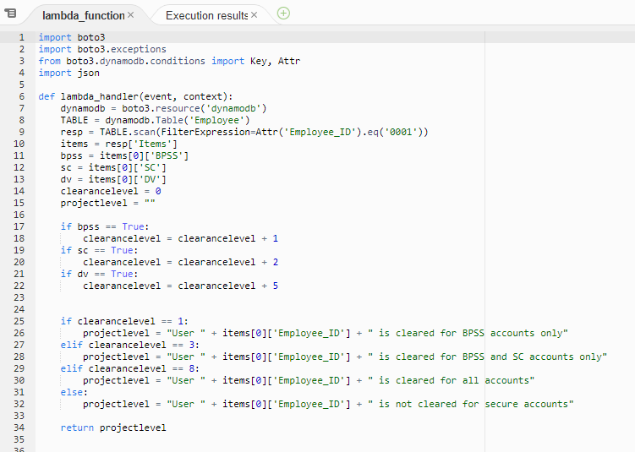
Microservice 4 Lambda Code

Slide 17
Lessons Learned

Slide 18
Lessons Learned
Lots of lessons picked up throughout the programming of the API’s.
Idempotency needs to be accounted for when performing CRUD operations on DynamoDB;
Payloads should be done via Json as opposed to parsing arguments where possible, due to mandatory arguments being required when using a parser. This caused issues when only sending key field information.
File handling is relatively straightforward but ideally, bucket names et. Al. should be variablised when possible to reduce wet code. Typo’s in bucket name caused a lot of consternation and confusion when writing the API.
Access Permissions and policies are complex. Case in point S3FullAccess does not allow a user to delete an object, giving access denied errors. A Lambda was the only solution for this.
DynamoDB is not suited for regular searching and scanning of database records. Alternatives such as RDS are better.
Code 200 returns are not always correct, code 200 indicates the endpoint was successfully hit by the API request, not that the function of the API was successful, additional code was required to handle exceptions.

Slide 19
References
Just me and Opensource, 2019. YouTube. [Online] Available at: https://www.youtube.com/watch?v=8zhv6GDSDE8 [Accessed 22 06 2021].
Mckendrick, J., 2021. ZDNet. [Online] Available at: https://www.zdnet.com/article/special-report-what-is-low-code-no-code-a-guide-to-development-platforms/ [Accessed 18 06 2021].
Microsoft, 2019. docs.microsoft.com. [Online] Available at: https://docs.microsoft.com/en-us/azure/architecture/microservices/model/domain-analysis [Accessed 19 06 2021].
Microsoft, 2019. docs.microsoft.com. [Online] Available at: https://docs.microsoft.com/en-us/azure/architecture/microservices/ [Accessed 07 06 2021].
Nash, J., 2019. Pythonise. [Online] Available at: https://pythonise.com/series/learning-flask/flask-http-methods#patch-requests [Accessed 02 06 2021].
Safi, M., 2019. obytes.com. [Online] Available at: https://www.obytes.com/blog/image-resizing-on-the-fly-with-aws-lambda-api-gateway-and-s3-storage [Accessed 22 06 2021].
SafiMed, 2019. Github. [Online] Available at: https://github.com/obytes/resize_s3_images/blob/master/resize_s3_images.py [Accessed 22 06 2021].
Stack Overflow, 2012. Stack Overflow. [Online] Available at: https://stackoverflow.com/questions/10607468/how-to-reduce-the-image-file-size-using-pil [Accessed 19 06 2021].
Stack Overflow, 2017. Stack Overflow. [Online] Available at: https://stackoverflow.com/questions/43215889/downloading-a-file-from-an-s3-bucket-to-the-users-computer [Accessed 25 06 2021].
Stack Overflow, 2018. stackoverflow.com. [Online] Available at: https://stackoverflow.com/questions/51048477/how-to-update-several-attributes-of-an-item-in-dynamodb-using-boto3 [Accessed 15 06 2021].
Wilinski, R., 2020. Dynobase. [Online] Available at: https://dynobase.dev/dynamodb-python-with-boto3/#update-item [Accessed 09 06 2021].
Wizard, C., 2019. Github. [Online] Available at: https://github.com/chief-wizard/serverless-python-image-resizing/blob/master/handler.py [Accessed 18 06 2021].
Amazon, 2021. AWS. [Online] Available at: https://docs.aws.amazon.com/apigateway/latest/developerguide/lambda-proxy-binary-media.html [Accessed 30 06 2021].
Amazon, 2021. AWS. [Online] Available at: https://docs.aws.amazon.com/AmazonS3/latest/userguide/add-bucket-policy.html [Accessed 30 06 2021].
Pheonix, J., n.d. Sempioneer. [Online] Available at: https://sempioneer.com/python-for-seo/image-resizing-in-python/ [Accessed 22 06 2021].
Akiwatkar, R., 2020. Simform. [Online] Available at: https://www.simform.com/serverless-examples-aws-lambda-use-cases/#website [Accessed 23 06 2021].
Amazon, 2021. AWS. [Online] Available at: https://docs.aws.amazon.com/apigateway/latest/developerguide/lambda-proxy-binary-media.html [Accessed 22 06 2021].
Amazon, 2021. AWS. [Online] Available at: https://docs.aws.amazon.com/amazondynamodb/latest/developerguide/GettingStarted.Python.03.html#GettingStarted.Python.03.03 [Accessed 22 06 2021].
Amazon, 2021. AWS. [Online] Available at: https://aws.amazon.com/architecture/reference-architecture-diagrams/?whitepapers-main.sort-by=item.additionalFields.sortDate&whitepapers-main.sort-order=desc&awsf.whitepapers-tech-category=*all&awsf.whitepapers-industries=*all [Accessed 13 06 2021].
Amazon, 2021. AWS.com. [Online] Available at: https://docs.aws.amazon.com/serverless-application-model/latest/developerguide/serverless-getting-started-hello-world.html [Accessed 10 06 2021].
Be a Better Dev, 2019. YouTube. [Online] Available at: https://www.youtube.com/watch?v=6LvtSmJhVRE [Accessed 06 06 2021].
Be a Better Dev, 2019. YouTube.com. [Online] Available at: https://www.youtube.com/watch?v=vXiZO1c5Sk0 [Accessed 06 06 2021].
Burke, K., 2020. flask-restful. [Online] Available at: https://flask-restful.readthedocs.io/en/latest/quickstart.html#full-example [Accessed 22 06 2021].
Just me and Opensource, 2019. YouTube. [Online] Available at: https://www.youtube.com/watch?v=6LvtSmJhVRE [Accessed 25 06 2021].

